Slide 1





Ad Time Prediction

Slide 2
Project Problem
Vox Media launched a beta version of a new ad product for clients
Key performance indicator is viewability.
This new ad displays on screen and in-view for X seconds. I want to predict the optimum in-view time in seconds that will yield the highest viewability rate.
Is there is a strong correlation between in-view time and viewability? If not, which variable affects viewability most?
Currently, our product team has been toying with two numbers: 10 seconds and 12.5 seconds, and performing simple A/B testing. This project will help determine the optimum time for this new product.

Slide 3
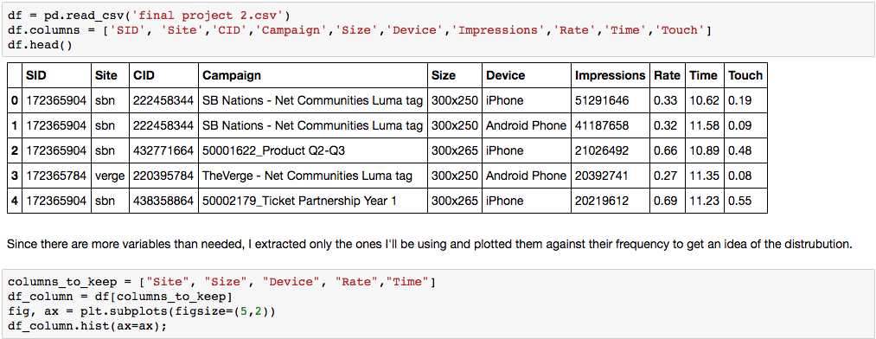
VARIABLES
Notes:
Since I have more variables than I need to build my model, I created a new columns to keep variable.
Create dummy variables for categorical columns – size, device, site

Slide 4
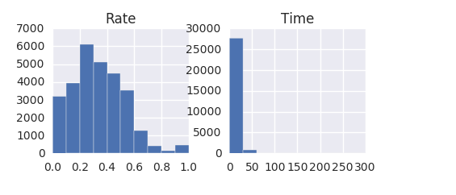
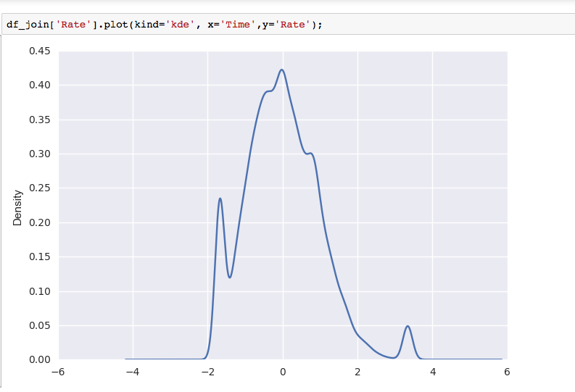
Distribution of Continuous Variables
Notes:
- Rate is skewed to the right
Time against rate looks to be normally distributed, with slight skewness to the right.
Mean time is 10.78
Mean rate is 33%

Slide 5
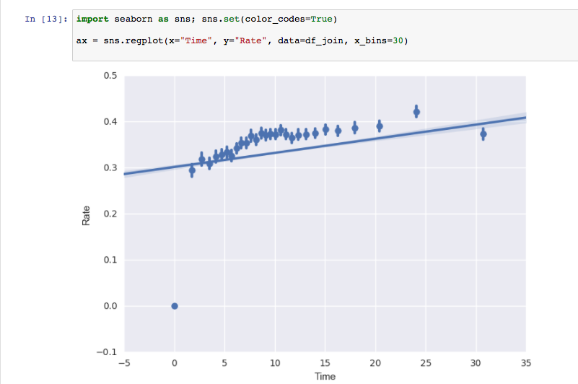
Distribution of Continuous Variables
Notes:
If we’re looking just at time against rate, it looks like we cap out around just before 11 seconds which is in line with what our product team was predicting. After that, viewability dips with a few outliers.

Slide 6
Project Concerns
Is there even a strong correlation between in-view time and viewability rate?
If not, which variable has the strongest correlation?
Does ad size matter (new beta ad is a 320x50).
Notes:
- Most correlated w/ 300x265 & Time

Slide 7
Modeling
Used OLS, Ridge, and Lasso to train my model. Ride provided the lowest MSE of 0.879
Since I was so unable w/ my scoring, I performed GridSearchCV to further train my model and find optimal parameters.
As a way to further customize parameters settings, I ran a Random Forest Regressor.
Notes:
- Being so high andall and shows that I need to further train my model.

Slide 8
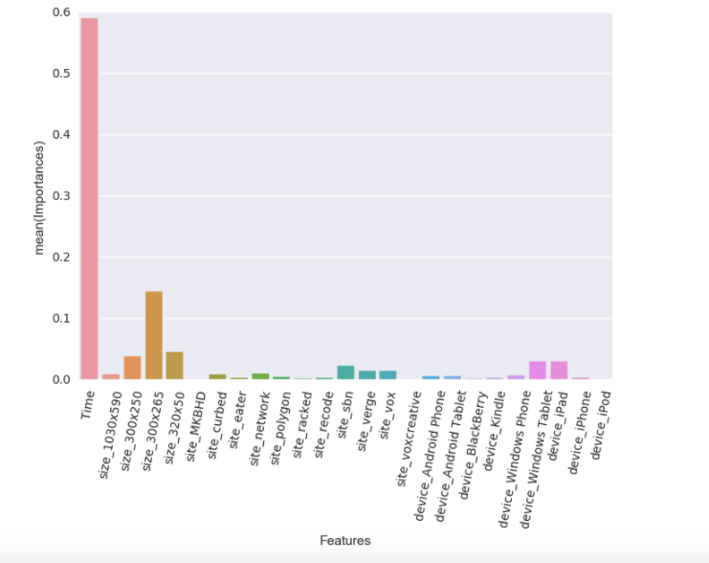
Feature Importance
Notes:
- This is a good sign! Time seems to be the most important feature compared to all other X values.

Slide 9
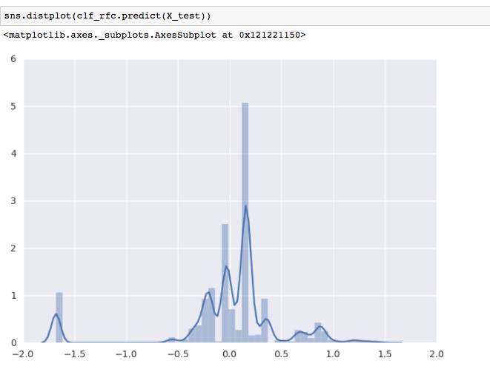
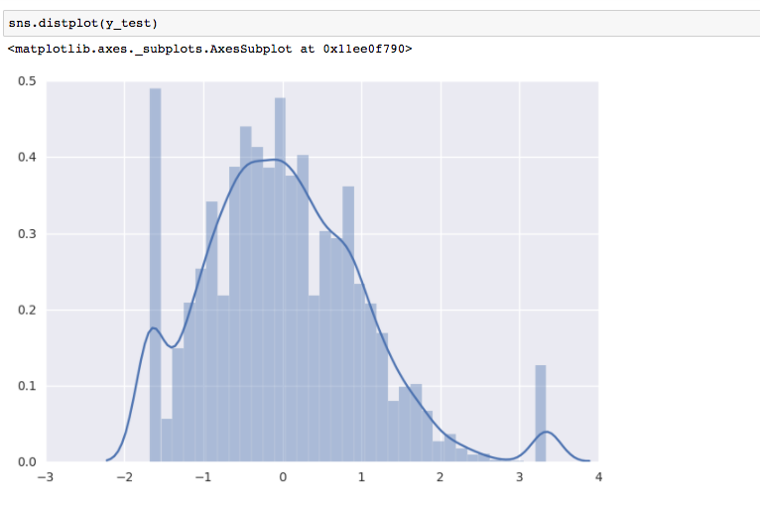
Plotting Model Prediction
Notes:
- So it looks like although both x & y variables are centered around 0, I’m still seeing a lot of variability. Random Forest also seems to be learning some of the noise which is demonstrated by the spikes toward the ends of the graph.

Slide 10
Prediction
After training our data, I was able to get my MSE down to 0.68 vs. 0.87.
Notes:
Not too many features which is why my scores were not the most ideal.
After training and tiring a few different modes, we arrived at an MSE of 0.67 which is better than the .87 I was seeing when I ran the OLS/Ridge/Lasso regression.

